Slide 1
A Community Conversation
Inclusionary Practices Project

Slide 2
Presenter
{Insert your name}
{Insert your connection to the community}
{Insert your contact information if appropriate}

Slide 3
Objectives
Share information about Inclusionary Practices work happening in our State and community
Discuss what inclusion means to you
Get your thoughts and advice

Slide 4
Group Agreements
Be inclusive allowing everyone to share.
Share from your own perspective using “I” statements.
Listen to build understanding, learning from others.
Practice self-care. Attend to your personal needs.
Respect confidentiality, personal information that is shared should remain in the meeting room.
Enjoy the time together!
Notes:
These are the group agreements we will hold in this space. Group agreements help us identify how we will show up together in this space.
{Read the agreements out loud}

Slide 5
Introductions
Share your name and your connection to our community.
What wisdom do you bring to this conversation?
Notes:
We are going to begin by getting to know each other a bit. We all hold different roles and have experiences that are meaningful to this conversation today. Please share your name, how you are connected to our community and then briefly answer the question: What wisdom do you bring to this conversation? You have 15 minutes. Please make sure everyone has a chance to share.

Slide 6
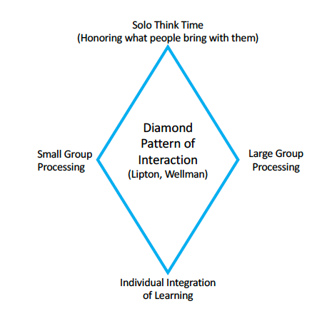
Process
Present Information
Individual Think Time
Small Group Discussion
2 Rounds of 20 minutes each
Large Group Discussion
10 minutes for each round
Notes:
During our time together, we are going to utilize a process called the Diamond Pattern of Interaction. Our goal is to provide multiple ways for your to share your thoughts and ideas. Please utilize the post it notes and paper on your table to draw, take notes, doodle, etc. At the end of the event we will collect all these items to harvest and share out all that we heard tonight.
Ok, Let’s get started.

Slide 7
Inclusionary Practices Professional Development Project
In 2019, the WA state legislature provided $25,000,000 to OSPI to implement professional development to support inclusion of students with disabilities.
The 2-year project is focused on implementation & support of inclusionary practices, with an emphasis on educator coaching and mentoring.
Notes:
The Inclusionary Practices project began in 2019, when our state legislature provided 25 million in funding to OSPI. This 2 year project is focused on implementation & support of inclusionary practices, with an emphasis on educator coaching and mentoring.

Slide 8
Increase use of evidence-based inclusionary practices.
Improve graduation rates for students with disabilities by increasing access to general education classes to support post-school goals.
Prepare students with disabilities for post- secondary education, employment, and civic engagement.
Increase confidence in students’ identities as lifelong learners.
Inclusionary Practices Project
Objectives
Notes:
The goals of the Inclusionary Practices Project are aimed at increasing access to the general education curriculum and learning environment for students with disabilities. There is also a coordinated effort to break down barriers between special education and general education.

Slide 9
Why is there a need for this project?
Washington is currently one of the least inclusive states, ranking 44 out of 50.
Only 57% of students with disabilities are included in general education settings for 80-100% of the school day.
Over 25% of students with disabilities are not engaged in higher education, employed, or involved in some other training program one year after they graduate.
https://www.k12.wa.us/policy-funding/special-education-funding-and-finance/inclusionary-practices-professional-development-project
Notes:
Lack of inclusion and access to general education and the curriculum and learning has a direct connection to opportunities after high school and has life-long impact. People are our community’s greatest asset and we want every young person to reach their full human potential.

Slide 10
What does inclusion and belonging look like, sound like and feel like to you?
Small Group Discussion
Notes:
We are going to move into our first discussion question.
{Read the question}
Take a minute to reflect on the question and write down what first comes to mind. I will let you know when the minute is up and to begin discussing the question at your tables.
Please use the markers and paper at your table to write down notes and draw pictures to illustrate your thoughts.

Slide 11
Large Group Share Out
Notes:
{Ask one person from each table to highlight a key point or two around what they heard or share and explain any drawings or visuals.}

Slide 12
Advancing the vision of inclusive schools and communities in Washington will require collaborative efforts among educators, families, and community professionals.

Slide 13
Positive Student Outcomes
Healthy Relationships
School, Work and Life Success
Active Community Involvement
It Takes a Community
Notes:
Effectively supporting inclusion requires meaningful partnerships and collaboration between families, schools and communities and businesses.
Inclusive practices need to happen in schools, but it doesn’t end there.

Slide 14
{Insert information about inclusive practices work in your school or district}
{If possible, highlight community partnerships that are supporting your inclusive practices work.}
Notes:
Here are some ways we are working together differently to be more inclusive in our schools.
{Add additional speaker notes to fit your slide}
{If you haven’t begun inclusionary practices work in your school/ district you can delete this slide}

Slide 15
What relationships are vital to develop and strengthen so that students can thrive as learners, future employees and community members? As we move through this work together, what are we missing?
Small Group Discussion
Notes:
We are going to move into our second set of discussion questions.
{Read the question}
Take a minute to reflect on the question and write down what first comes to mind. I will let you know when the minute is up and to begin discussing the question at your tables.
Please use the markers and paper at your table to write down notes and draw pictures to illustrate your thoughts.

Slide 16
Large Group Share Out
Notes:
Ask one person from each table to highlight a key point or two around what they heard or share and explain any drawings or visuals.

Slide 17
Harvest
As you reflect on what was shared today…
What did you hear that resonates with you?
What ideas did you hear that we can work together to take action on?
Notes:
It sounds like there was a lot of great discussion. Let’s think about next steps we can take as a community
{Just popcorn around the room and let people share. Have someone take notes on what you hear}

Slide 18
What’s Next?
Harvest information that was shared today
Share with our school leaders, community partners and all of you
For more information on the Inclusionary Practices Professional Development Project:
https://www.k12.wa.us/policy-funding/special-education-funding-and-finance/inclusionary-practices-professional-development-project
Notes:
We heard some great ideas and reflections today. We captured notes and will be collecting all the notes and drawings from your tables to ensure we capture everything we heard today. We will identify actions steps we as a community can take and work together on. You can expect to receive an email from us within a few weeks sharing out a recap of this event and actions steps we plan to take.

Slide 19
Notes:
Thank you all for joining us and giving your time. We cannot do this work alone and look forward to continuing to collaborate and partner as we work to become a more inclusive community.
Please take a few moments to fill out the short evaluation form at your table. Your feedback is important to us. When completed just leave them on the table we will collect them.

